Slide 1
Information Technology Infrastructure Library -(ITIL)
BAI3020 Strategic Planning and Project Management

Slide 2
What is ITIL?
ITIL – Information Technology Infrastructure Library
IT Organizations are challenged continuously to improve their ability to deliver services at costs affordable to customers therefore ITIL is an approach to:
Systematic approach to high quality IT service delivery
Documented best practice for IT Service Management
Provides common language with well-defined terms
Developed in 1980s by what is now The Office of Government Commerce
Vendor Neutral (UK)

Slide 3
Best Practices to enable corporations to:
Offer value to customers through services
Maximize and reduce costs
Optimize service strategy with the business
Improve Relationships with customers
Monitor service
Optimize service
Utilize metrics for service
Manage knowledge
Manage IT investment and budget
Manage risk
Mature culture

Slide 4
Service and Outcomes
Service
Delivers value to customer by facilitating outcomes customers want to achieve without ownership of the specific costs and risks
Example: A backup service means that you as a Unit don’t have to care about how much tapes, disks or robots cost and you don’t have to worry if one of the staff is off sick or leaves
Outcome
Result of delivering a service

Slide 5

IT Services
IT Service are services provided to a corporation made up of a combination:
IT
People
Processes

Slide 6
Service level & Agreement
Service Level
Measured and reported achievement against one or more service level targets
E.g.
Red = 1 hour response 24/7
Amber = 4 hour response 8/5
Green = Next business day
Service Level Agreement
Written and negotiated agreement between Service Provider and Customer documenting agreed service levels and costs

Slide 7
Configuration Management
Configuration Management System (CMS)
Tools and databases to manage IT service provider’s configuration data
Contains Configuration Management Database (CMDB)
Records hardware, software, documentation and anything else important to IT provision

Slide 8
Release
Collection of hardware, software, documentation, processes or other things require to implement one or more approved changes to IT Services

Slide 9
Types of Issues
Incident
Unplanned interruption to an IT service or an unplanned reduction in its quality
Work-around
Reducing or eliminating the impact of an incident without resolving it
Problem
Unknown underlying cause of one or more incidents

Slide 10
Service Delivery Strategies
Strategy | Features
In-sourcing | All parts internal
Out-sourcing | External resources for specific and defined areas (e.g. Contract cleaners)
Co-Sourcing | Mixture of internal and external resources
Knowledge Process Outsourcing (domain-based business expertise) | Outsourcing of particular processes, with additional expertise from provider
Application Outsourcing | External hosting on shared computers – applications on demand (e.g. Survey Monkey)
Business Process Outsourcing | Outsourcing of specific processes e.g. HR, Library Circulation, Payroll
Partnership/Multi-sourcing | Sharing service provision over the lifecycle with two or more organisations

Slide 11
Types of Service and Service Catalogue
Business Process Customer A (HR)
Business Process B Customer B (Sales)
Business Process C Customer C (R&D)
Business Service Catalogue [CREATE SLA’s]
Visible to Customer
Service 1
Service 2
Service 3
Service 4
Service 5
Service 6
Technical Service Catalogue
Invisible to Customer
Hardware
Software
Support
Applications
Databases
Capability
Keeps service information away from business information Providing
accurate and consistent information enabling service-focussed working

Slide 12
Service Value
Service Utility:
what the customer gets in terms of outcomes supported and/or constraints removed
Service Warranty:
how the service is delivered and its fitness for use, in terms of availability, capacity, continuity and security.

Slide 13
IT Service Management (ITSM)
Service Management
Set of organizational capabilities to provide value to customers in the form of services
ITSM
Implementation and management of IT services meeting the needs of the business

Slide 14
Issues with IT service management
Services are intangible to:
Measure
Control
Validate
Demand couples with client assets
No buffer – requires immediate attention
Are perishable

Slide 15
3 types of service providers
Internal service provider
Embedded in Business Unit (BU)
Shared service unit
Shared IT services to more than 1 BU
External service provider
Proving IT services to external customers

Slide 16
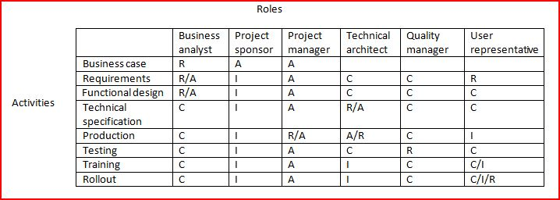
RACI Model
Helps to determine roles and responsibilities
R (responsibility), A (Accountability), C (Consulted), I (Informed)

Slide 17
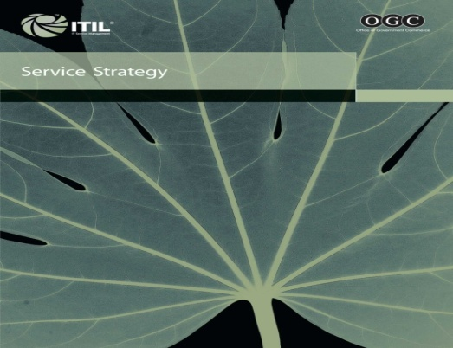


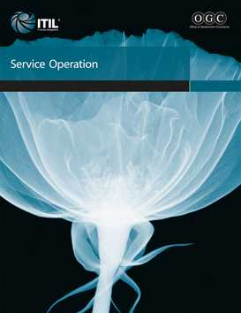
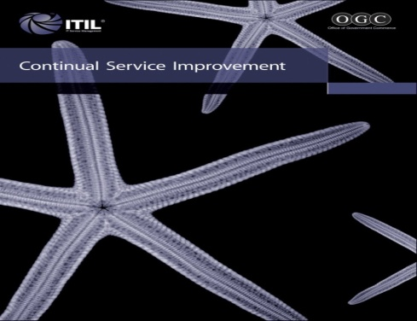
Core ITIL v3 Library
Service Strategy (SS)
Service Design (SD)
Service Transition (ST)
Service Operations (SO)
Continual Service Improvement (CSI)

Slide 18
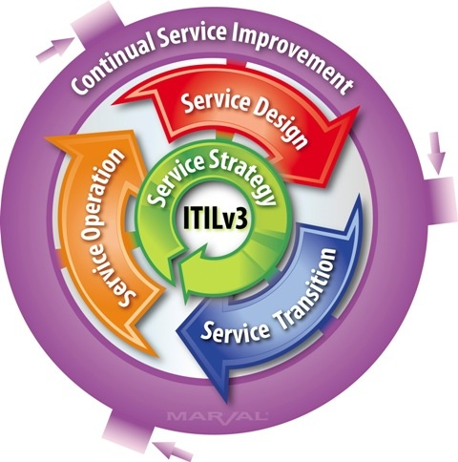
How the Lifecycle stages fit together

Slide 19
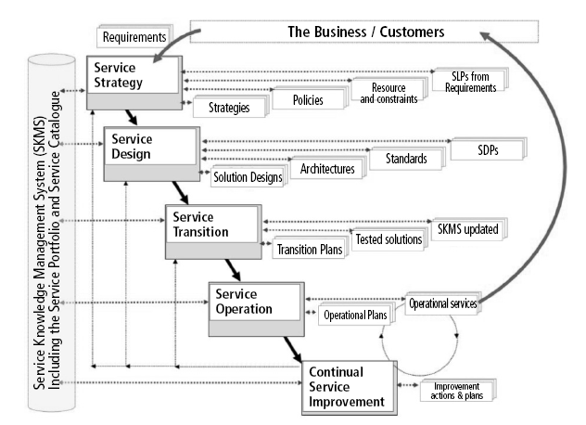
Key links, inputs & outputs of the service lifecycle stages
SLP – Service Level Package SDP – Service Design Package

Slide 20
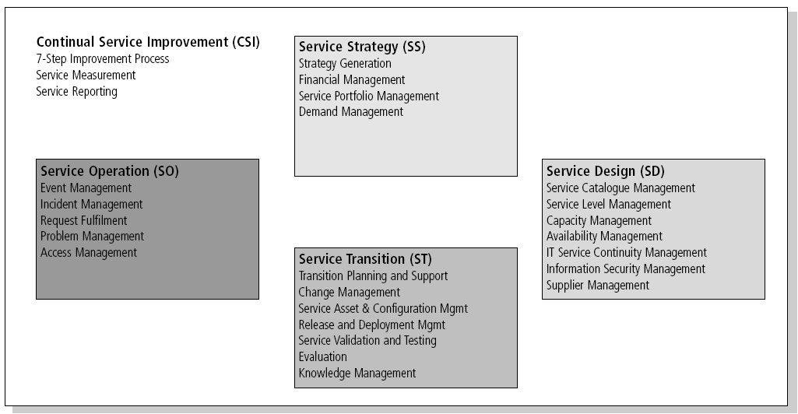
ITIL V3 Processes across Service Life Cycle

Slide 21
Service Strategy
What are we going to provide?
Can we afford it?
Can we provide enough of it?
How do we gain competitive advantage?
Perspective
Vision, mission and strategic goals
Position
Plan
Pattern
Must fit organisational culture

Slide 22
Service Strategy
Service Strategy is NOT just a Capability of the organization but also a Strategic Asset
The Service strategy helps the organization to position themselves to handle unique costs and risks associated with their service portfolio.
Service strategy challenges IT service providers to think about why something is being done before thinking about how it should be done

Slide 23
Service Design
How are we going to provide it?
How are we going to build it?
How are we going to test it?
How are we going to deploy it?
Holistic approach to determine the impact of change introduction on the existing services and management processes

Slide 24
Service Design
The Service Design takes the strategies and decisions made from the previous stage and translates them into a blueprint for delivering those service and capabilities

Slide 25
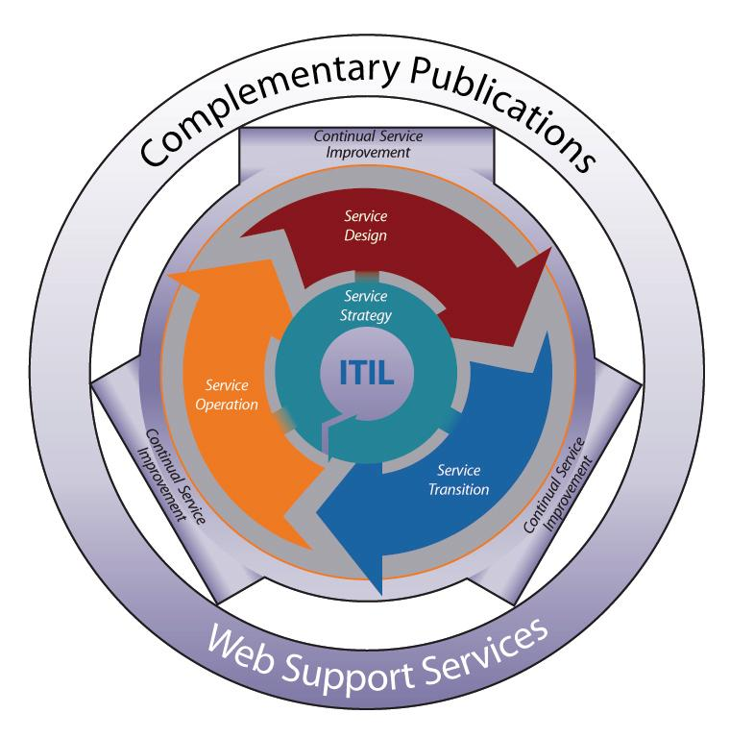
Service Design
Responsible for the design of new or changed services going into a live environment.
Ensure designs are consistent, compatible and capable.
Metrics definition, selection and evaluation of measurement capabilities.
Evaluation and establishment of policies/procedures for new or changed services.
Key output of Service Design – Design solutions to meet the changing requirements of the business.

Slide 26
Service Transition
The Service Transition stage concerns the introduction of new or changed services into supported environments
For success requires careful transition planning, testing, communication and training
This is done to ensure effective transitioning to the service operation stage

Slide 27
Service Transition
Build
Deployment
Testing
User acceptance
Ensure Embedded in system

Slide 28
Service Transition
Plan and manage the capacity and resources required to package, build, test and deploy into production.
Provide a consistent and rigorous framework for evaluating risk.
Ensure that services can be managed, operated and supported as specified from Service Design.
Communication and documentation of information for decision making and deployments into production.

Slide 29
Good service transition
Set customer expectations
Enable release integration
Reduce performance variation
Document and reduce known errors
Minimise risk
Ensure proper use of services
Some things excluded
Swapping failed device
Adding new user
Installing standard software

Slide 30
Knowledge management
Vital to enabling the right information to be provided at the right place and the right time to the right person to enable informed decision
Stops data being locked away with individuals
Obvious organisational advantage

Slide 31
Key Processes and Activities
Change Management is to ensure that standardized methods are used for the efficient and prompt handling of all changes, that all changes are recorded in the Configuration Management System and that overall business risk is optimized.
Service Asset and Configuration Management is to identify, control and account for service assets and configuration items (CI), protecting and ensuring their integrity across the service lifecycle.
Knowledge Management is to ensure that the right person has the right knowledge, at the right time to deliver and support the services

Slide 32
Service Operation
The Service Operation Stage concerns the effective delivery and support of operational services
It is extremely important for the IT service provider to manage and deliver the service at the SLA levels to ensure value for its customer and users

Slide 33
Service Operation
Maintenance
Management
Realises Strategic Objectives and is where the Value is seen

Slide 34
Processes in Service Operation
Incident Management
Problem Management
Event Management
Request Fulfilment
Access Management

Slide 35
Incident Management
Deals with unplanned interruptions to IT Services or reductions in their quality
Failure of a configuration item that has not impacted a service is also an incident (e.g. Disk in RAID failure)
Reported by:
Users
Technical Staff
Monitoring Tools

Slide 36
Event Management
3 Types of events
Information
Warning
Exception
Can we give examples?
Need to make sense of events and have appropriate control actions planned and documented

Slide 37
Request Fulfilment
Information, advice or a standard change
Should not be classed as Incidents or Changes
Can we give more examples?

Slide 38
Problem Management
Aims to prevent problems and resulting incidents
Minimises impact of unavoidable incidents
Eliminates recurring incidents
Proactive Problem Management
Identifies areas of potential weakness
Identifies workarounds
Reactive Problem Management
Indentifies underlying causes of incidents
Identifies changes to prevent recurrence

Slide 39
Access Management
Right things for right users at right time
Concepts
Access
Identity (Authentication, AuthN)
Rights (Authorisation, AuthZ)
Service Group
Directory

Slide 40
Functions in Service Operation
Service Desk
Technical Management
IT Operations Management
Applications Management

Slide 41
Service Operation Balances
Cost
B
Stability
Responsiveness
A
Reactive
Proactive
Quality

Slide 42
Continual Service Improvement (CSI)
CSI concerns both incremental and large-scale improvements across the service lifecycle
This involves feedback systems

Slide 43
Continual Service Improvement Model
What is the vision?
High Level
Objectives
Where are we now?
Assessments
How do we keep the
momentum going?
Where do we want
to be?
Measurable
Targets
How do we get
there?
Process
Improvements
How do we check
we got there?
Measurement
And Metrics

Slide 44
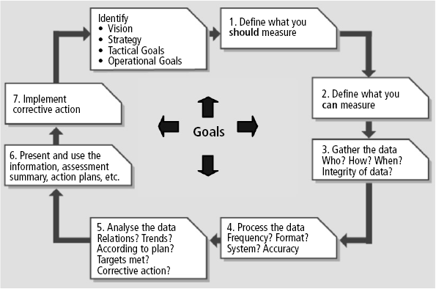
7-Step Improvement Process

Slide 45
Continual Service Improvement
Focus on Process owners and Service Owners
Ensures that service management processes continue to support the business
Monitor and enhance Service Level Achievements
Plan – do –check – act (Deming)

Slide 46
Service Measurement
Technology (components, MTBF etc)
Process (KPIs - Critical Success Factors)
Service (End-to end, e.g. Customer Satisfaction)
Why?
Validation – Soundness of decisions
Direction – of future activities
Justify – provide factual evidence
Intervene – when changes or corrections are needed

Slide 47
ITIL Roles
Process Owner
Ensures Fit for Purpose
Process Manager
Monitors and Reports on Process
Service Owner
Accountable for Delivery
Service Manager
Responsible for initiation, transition and maintenance. Lifecycle!

Slide 48
More Roles
Business Relationship Manager
Service Asset & Configuration
Service Asset Manager
Service Knowledge Manager
Configuration Manager
Configuration Analyst
Configuration Librarian
CMS tools administrator

